Slide 1
goLoop: SMT-Based Loop Analysis via Global Optimization 2nd International Workshop on Reconfigurable Transition Systems: Semantics, Logics and Applications ReacTS 2025 Markus Krahl, Matthias Güdemann, and Stefan Wallentowitz
Faculty of Computer Science
and Mathematics

Slide 2
Introduction
Reconfigurable Transition Systems (RTS) often handle safety-critical tasks
Use of formal verification techniques recommended/required
RTS might involve long, variably bounded loops
Bounded Model Checking (BMC) widely used for verifying safety properties
BMC underapproximates program space up to a fixed bound
Problem: BMC has poor scalability for increasing bounds of (nested) loop-constructs
Idea: Global Optimization approach to analyze programs involving loops

Slide 3
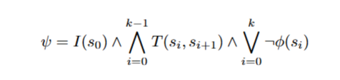
Theory of BMC
Analyzed program is modelled as state transition system
BMC unrolls the system k times and generates a Verification Condition (Ψ) that is satisfiable iff a counterexample for property Φ exists:
Verification Condition is in first-order-logic and checked by SAT/SMT-solver
If SAT, counterexample exists that violates property Φ
Problem: Bound k may lead to insufficient loop unrolling (underapproximation)

Slide 4
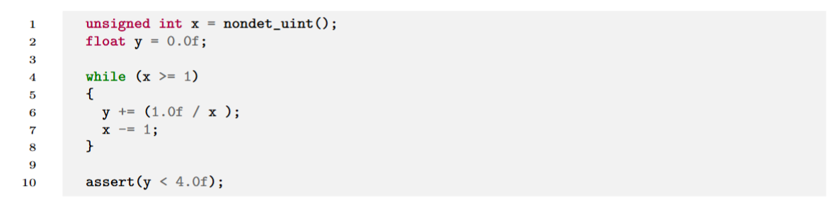
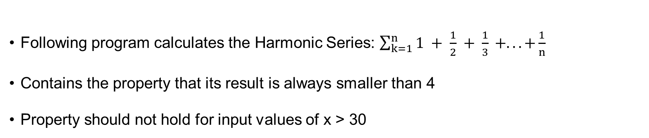
Motivating Example (1)
Following program calculates the Harmonic Series: $\sum_{k=1}^{n}{1 + \frac{1}{2} + \frac{1}{3} +... +\frac{1}{n}}$
Contains the property that its result is always smaller than 4
Property should not hold for input values of x > 30

Slide 5
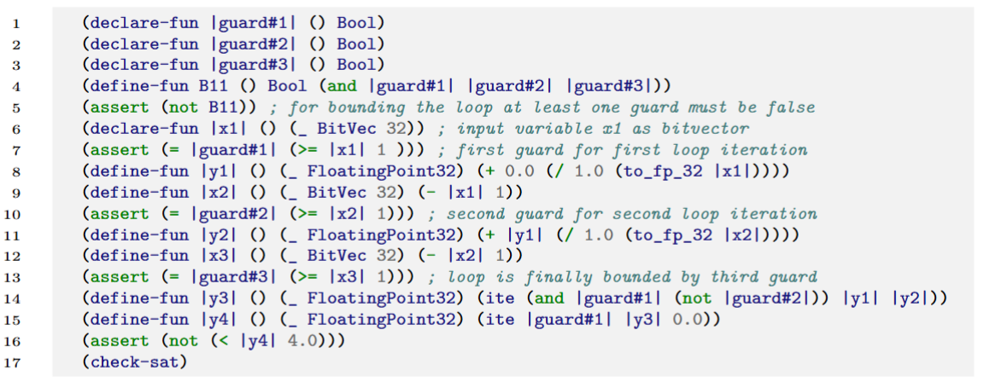
Motivating Example (2)
Using C Bounded Model Checker (CBMC) with bound k = 3
Following SMT equation is generated (simplified SMT-LIB2 syntax)
Bound implicitly restricts x to [0, 2]

Slide 6
Motivating Example (3)
Solving-time for VC generated with bound k = 3 and x in [0 , 2]: 0.1 seconds – UNSAT
Solving-time for bound k = 21 and x in [0 , 20]: 2.4 seconds – UNSAT
Solving-time for bound k = 32 and x in [0 , 31]: 5.7 seconds – SAT:
x = 31 and y ≈ 4.027
Solving-times do not scale properly

Slide 7
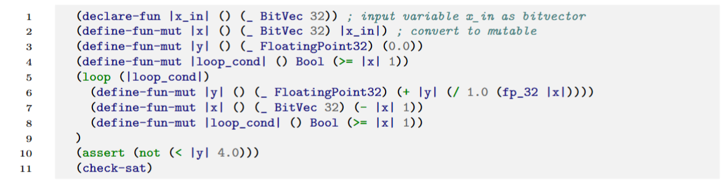
Motivating Example (4)
Idea: Formulate BMC problem as global constraint optimization problem
Loops are not unrolled but treated as executable function in optimization process
Extend syntax for SMT equation to encode loops:

Slide 8
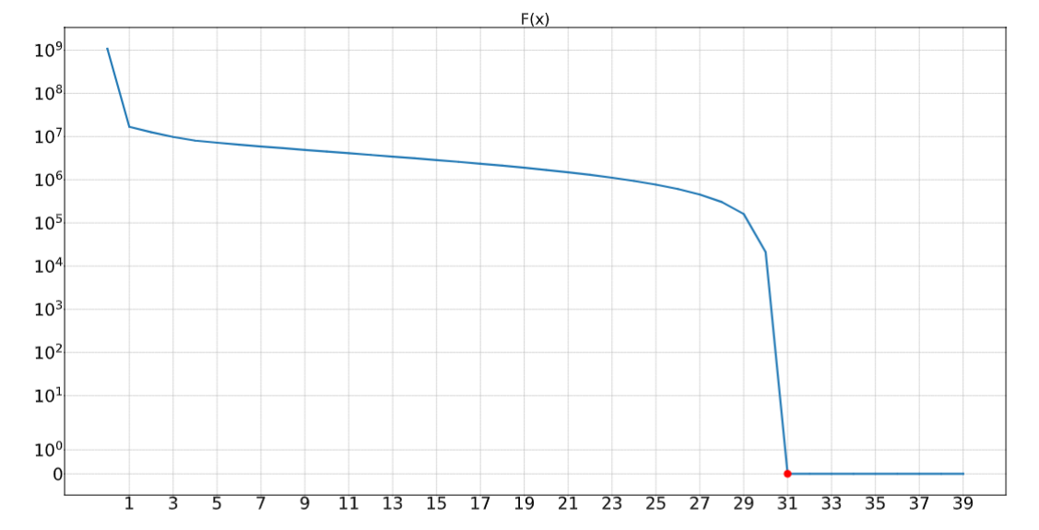
Motivating Example (5)
Objective function F(x) to encode the SMT equation
Solving-time of GO approach (basinhopping): 0.025 seconds
Every x in [31 , …] corresponds to a satisfying assignment
Plot over the interval x in [0, 39]

Slide 9
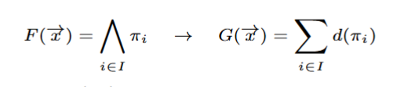
Encoding SMT Equations as Optimization Problem (1)
Quantifier-free SMT equation F(x) is transformed into objective function G(x)
If x1 is satisfiable assignment of F, then G(x1) returns 0
G(x) must always return non-negative values and must return zero iff its input corresponds to a satisfying assignment of F
Conjunction of asserted Boolean constraints of an SMT equation are converted as:
Notes:
X in the set of program input domain

Slide 10
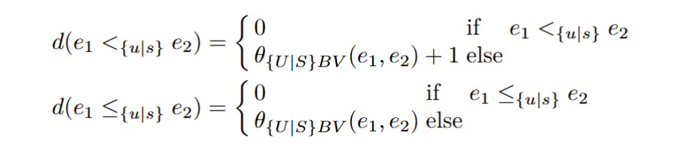
Encoding SMT-Equations as Optimization Problem (2)
Optimization functions builds upon distance function d(π)
d(π) translates Boolean expressions to real values (greater or equal to zero)
d(T) = 0 | d(F) = 1 | d( a && b) = d(a) + d(b) | d(a || b) = d(a) * d(b) | d(-a) = 0 if a F, 1 otherwise
Example for comparison operator (e1 and e2 are Bitvectors):
Notes:
Real values equal or greater than zero
Same applies for FP Theory

Slide 11
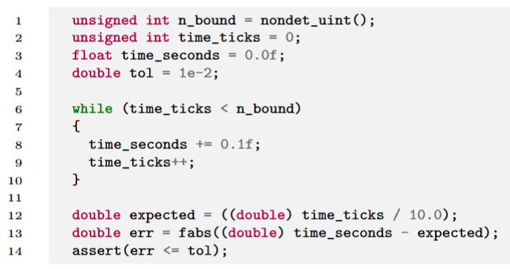
Example
Verify that absolute error between measured and expected time remains within a tolerance of 10−2 seconds
Due to Floating-Point arithmetic, the given assertion may fail for large values of n_bound
Does there exist a n_bound for which the assertion fails?
Notes:
Does there exist a n_bound for which the assertion fails?

Slide 12
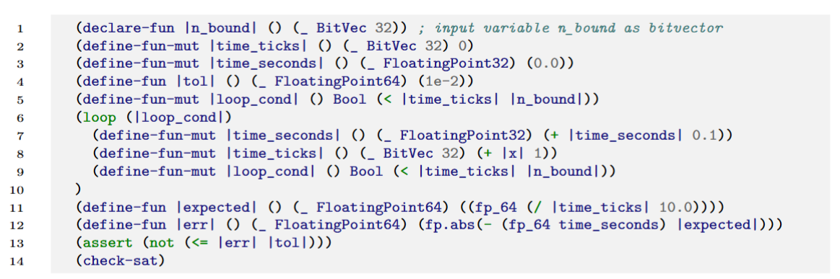
Example
Formulated as SMT-Equation with Loop and mutable extension
(define-fun-mut symbol-name) allows variable reassignment
(loop loop-cond) (loop-iteration-statement+) to specify unbounded loop-constructs
Notes:
Mention here in detail loop and mut operator

Slide 13
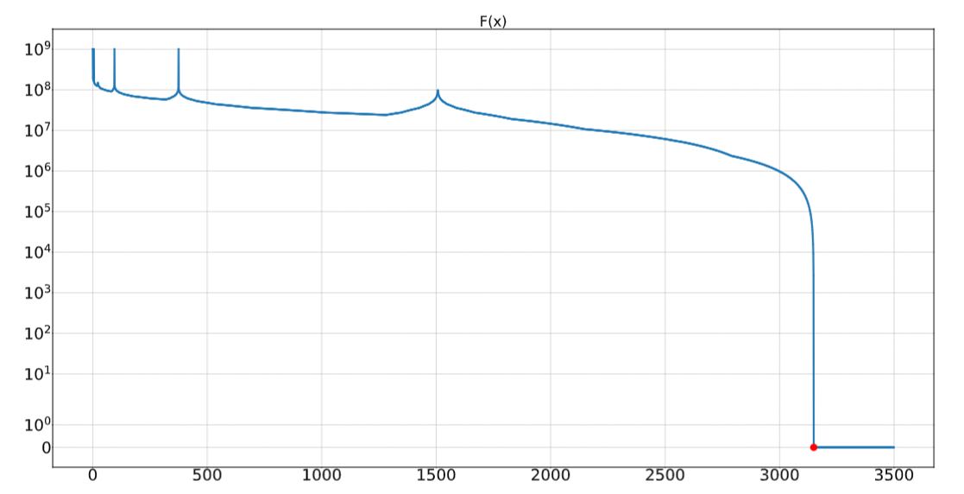
Example
Plot of objective Function F(x) (x := n_bound)
Solving-Time CBMC – goLoop: 1.4 minutes – 1.2 seconds

Slide 14
Strengths and Weaknesses
No further modifications/adaptions of analyzed program required
Support for any derivative-free GO algorithm
Increase of performance due to native execution speed of optimization function
Support for pre-compiled dependencies of the investigated program
No analysis of programs with infinite-loops
Cannot be used to check loop termination
Unsound: Cannot prove UNSAT

Slide 15
Conclusion and Future Work
goLoop shows promising results on presented examples
Potential as complementary technique next to BMC or other tools
Focus on developing an integrated tool based on goLoop
Extensive evaluation of goLoop and other BMC techniques
Investigate potential to combine goLoop with BMC/SMT techniques

